Slide 1
Exercise 3 matrix – matrix multiplication & random matrix theory
QUANTUM INFORMATION AND COMPUTING course 2021/2022
Alessandro marcomini (2024286)
Prof. Simone montangero

Slide 2
Exercise goals
PART I
Investigate the scaling of different matrix – matrix multiplication subroutines in FORTRAN via PYTHON interface
PART II
Generate large random Hermitian matrices and diagonal real matrices
Investigate the statistical distribution of eigenvalues spacings of these matrices

Slide 3

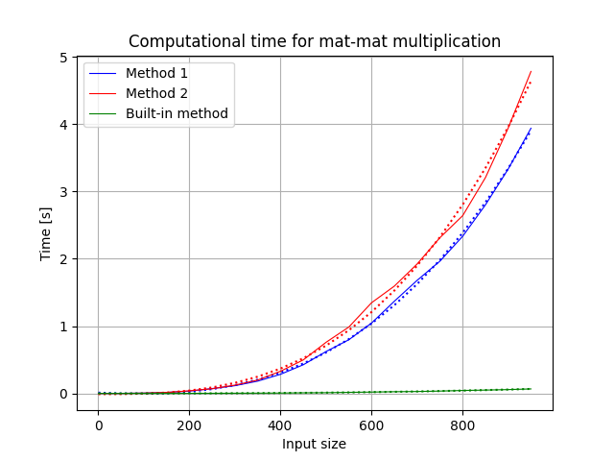
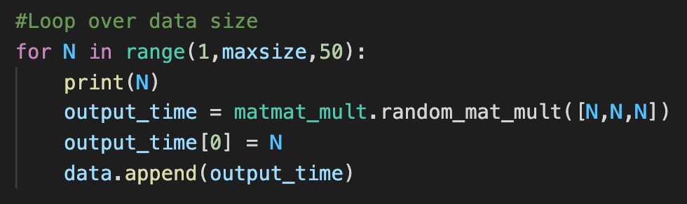
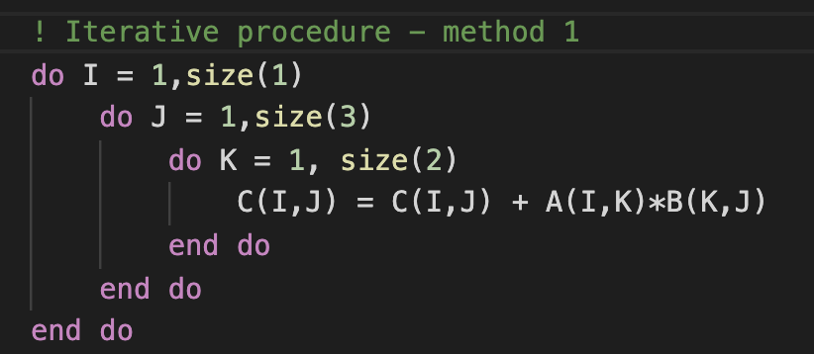


PART I – Matrix matrix multiplication
Three methods under investigation: most external loop on output’s rows, on output’s columns, built-in (optimized) multiplication method MATMUL
Verification of compatibility among methods (sum up to ${10}^{−6}$)
Interfaced via F2PY
Does not work with allocatable variables…
Fit – scipy.polyfit(order = 3)

Slide 4
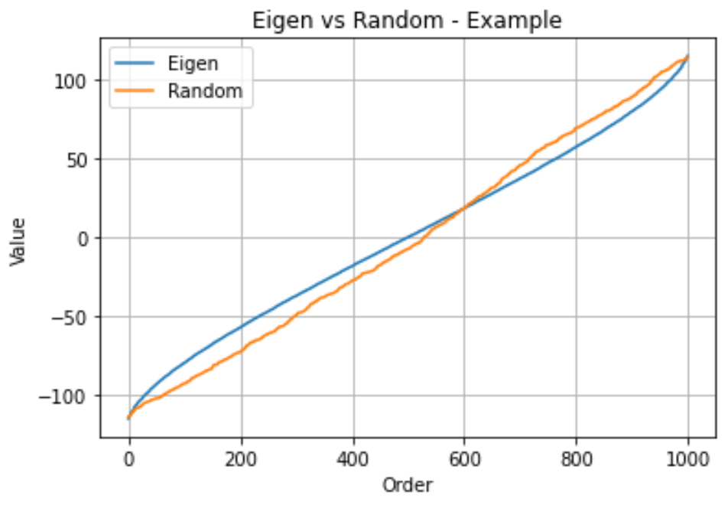
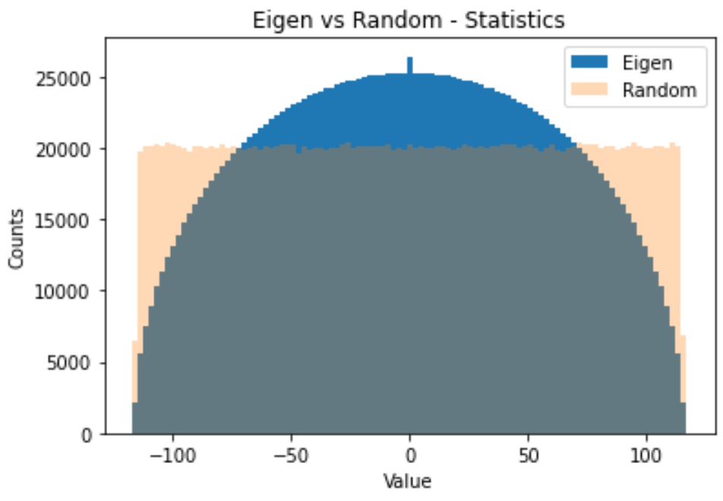
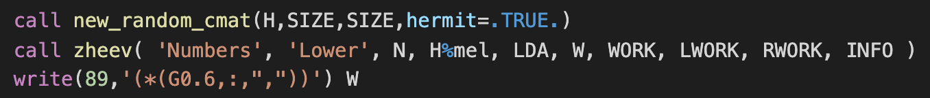

PART II – RANDOM matrix THEORY
Implementation of Hermitian case in the user defined type
Generation of 2k random Hermitian matrices of size (1k x 1k) with $Re, Im$uniformly in $(−1,1)$ and random real diagonal matrices
Eigenvals calculation via ZHEEV
Visualization and test (compatibility with trace up to ${10}^{−6}$)

Slide 5
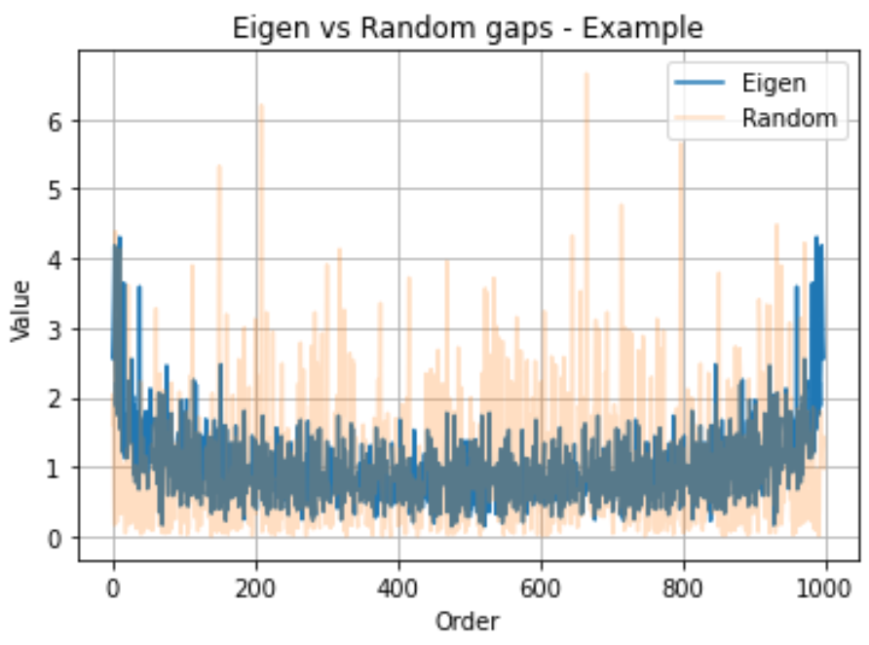
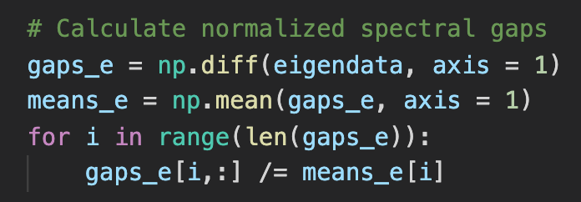
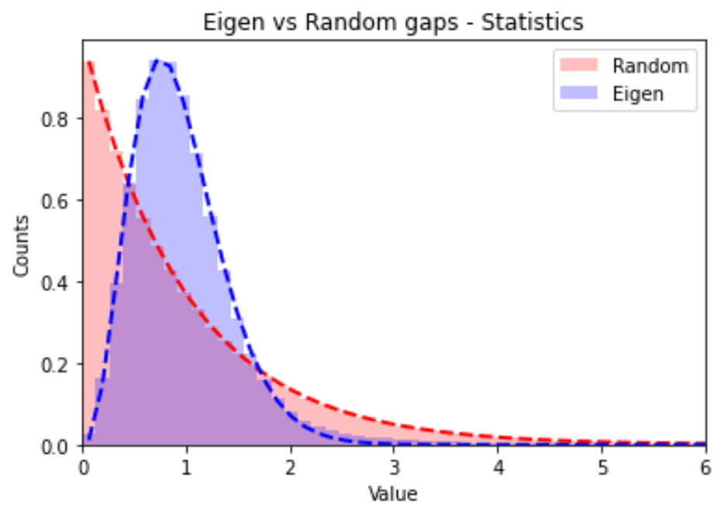




PART II – RANDOM matrix THEORY
Calculation of spacings and global average normalization:
Histograms and interpolations
Overflow encountered
Rebinning
Scipy problems in fitting negative numbers with real exponent
$$s_{i}=Δλ_{i}/\overline{Δλ}$$
$$13.2 s^{2.57}\exp\left(−2.78{ s}^{1.33}\right)$$
$$0.99 s^{−0.01}\exp\left(−0.98 s^{1.01}\right)$$
$$≈exp(−s)$$

Slide 6

What should I have expected?
Matrix matrix multiplication
Random matrix theory
Expected scaling order: $O(n^{3})$
Fortran stores matrix elements columnwise: impact on computational time
Built-in method optimized
Wigner theory:
Semicircle law
Wigner’s surmise
Random real values:
Uniformly distributed values
Exponential (Poissonian) distribution of spacings

Slide 7
REFERENCES
Distribution of Eigenvalue Spacings for Band-Diagonal Matrices (N. Miller) http://web.math.princeton.edu/mathlab/jr02spring/rmt/banddiag.pdf
Wigner’s theory & Gaussian Ensambles:
https://www.math.harvard.edu/media/feier.pdf
Check full work on GitHub: email alessandro.marcomini.1@studenti.unipd.it

